Slide 1

Car Insurance Claim Probability Prediction

Slide 2
Introduction
Problem statement : Develop a predictive model that assesses the claim probability for car insurance policies.
Objective : Understand the factors influencing claim frequency and severity over a six-month period.
Benefits : Enable insurance companies to better assess risk and determine appropriate premiums for policyholders.

Slide 3
Step 1
Step 3
Model Evaluation and Performance
Step 4
Results
Step 5
Step 2
Exploratory Data Analysis (EDA)
Model Development
Approach
Conclusion

Slide 4
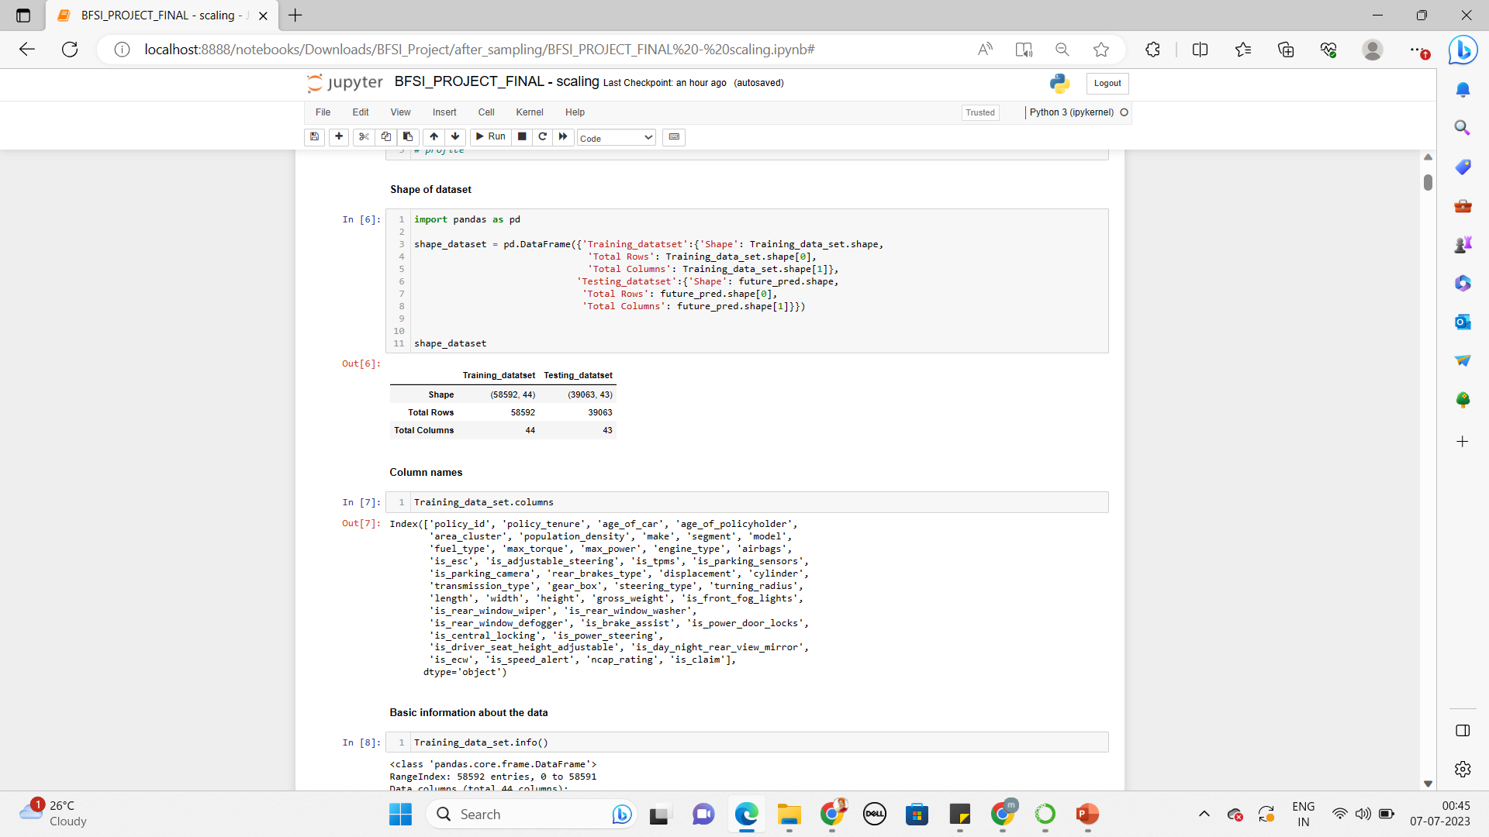
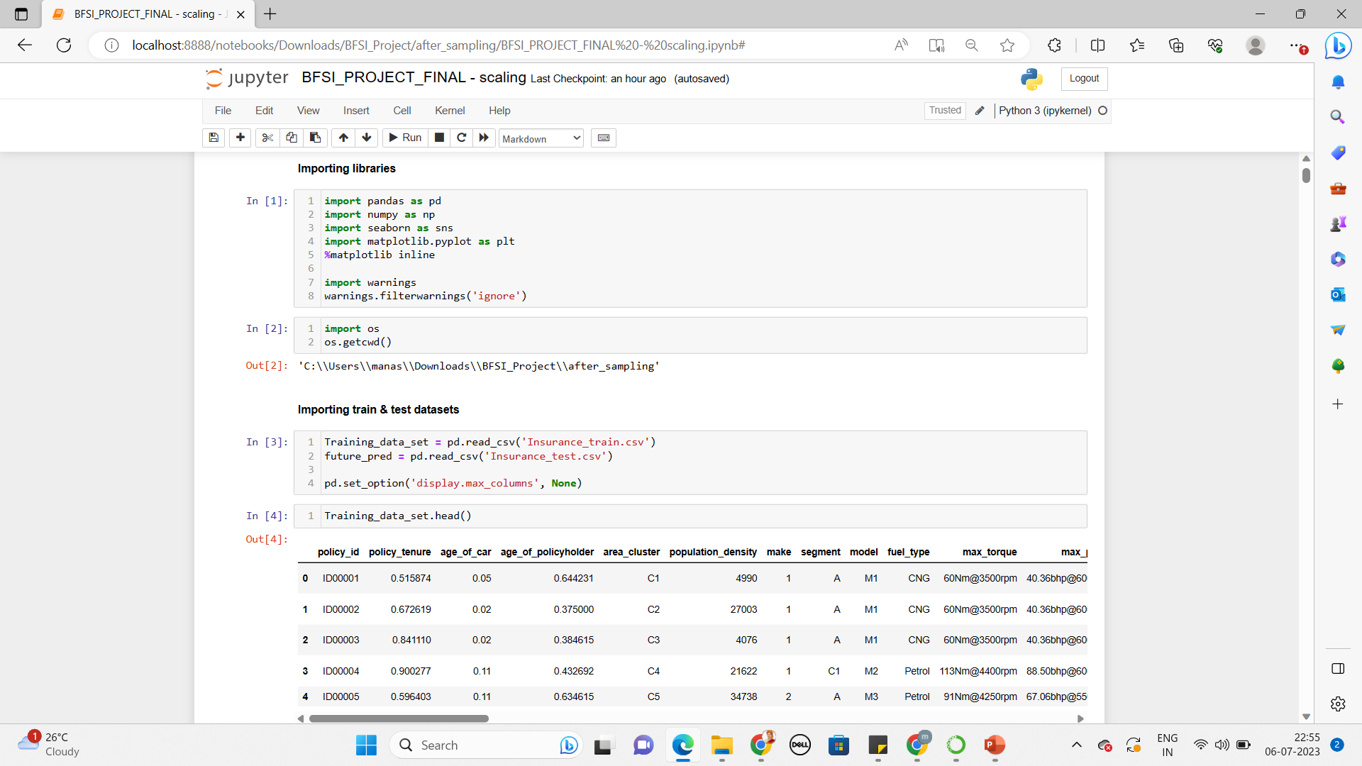
Exploratory Data Analysis (EDA)
Conducted an analysis of the car insurance dataset to understand the variables and their relationships.
Explored the distribution of claim frequency and severity.
Examined the correlation between different features and claim probability.
Importing all the required libraries & datasets
Checking Shape of dataset & column name

Slide 5
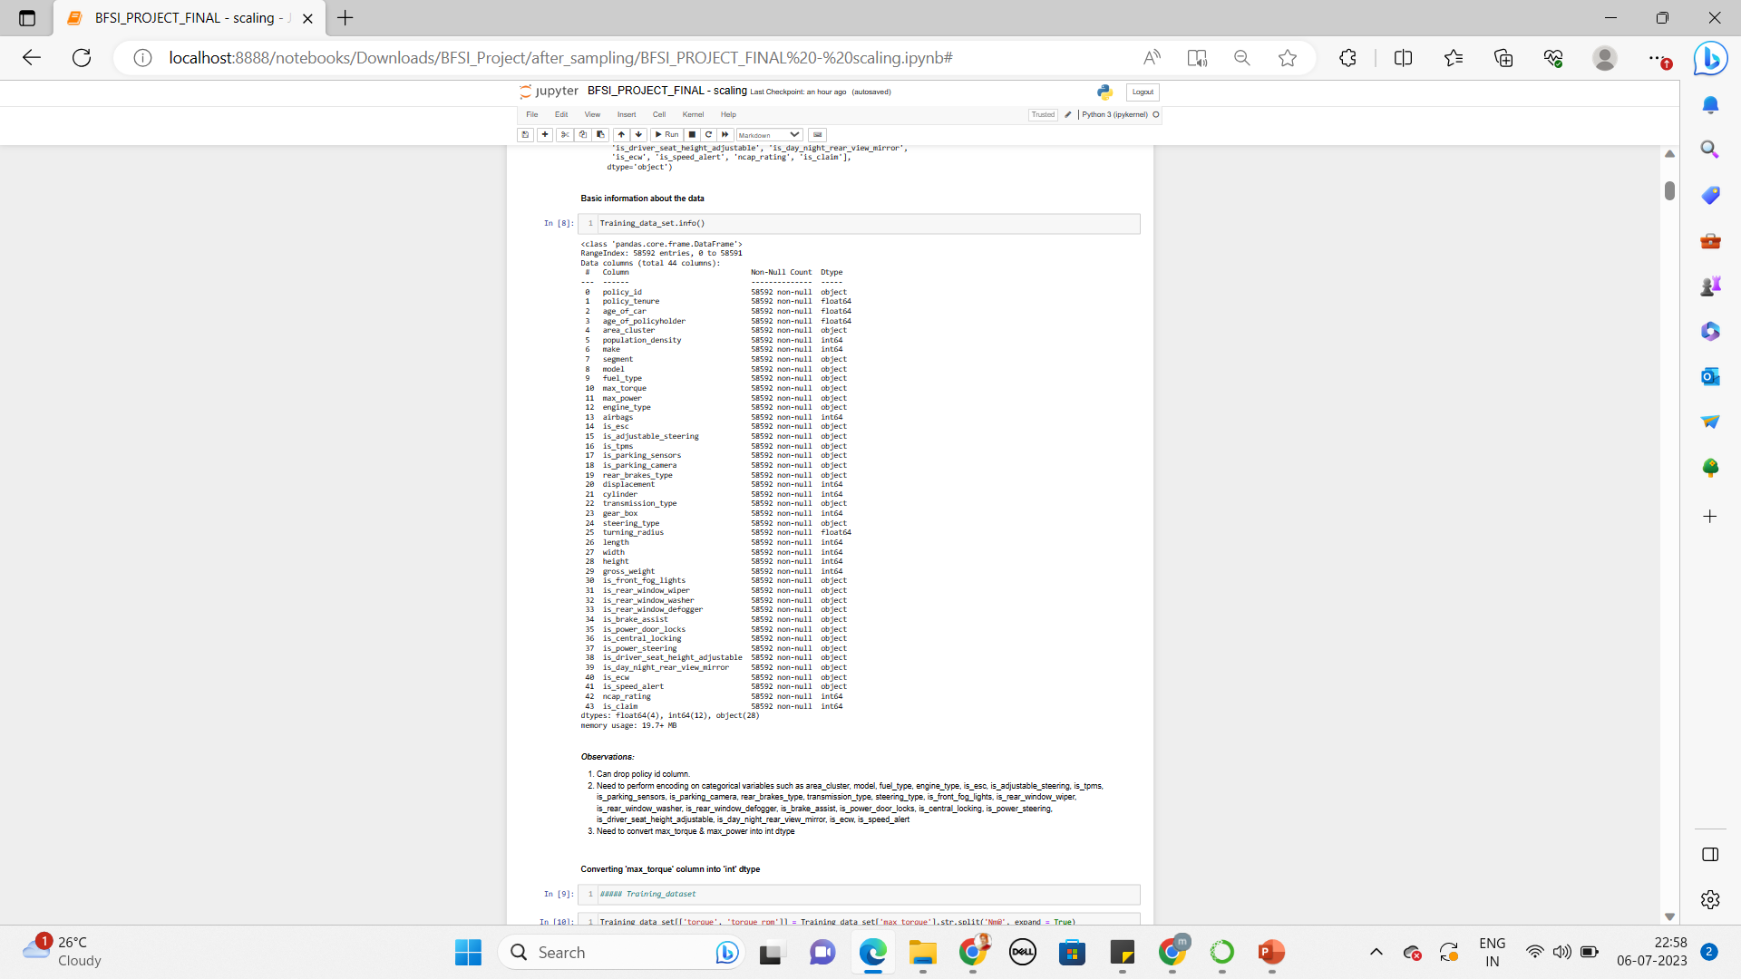
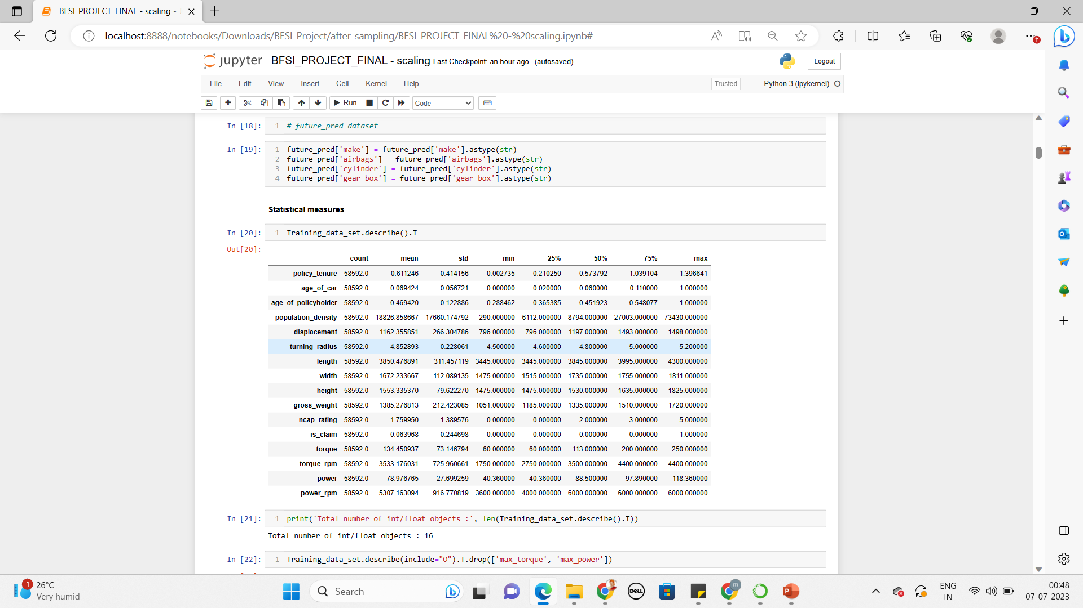
Analyzing the dataset
Information about dataset

Slide 6
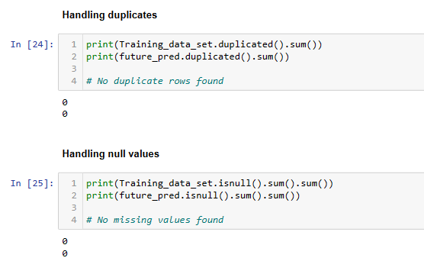
Handling duplicates & null value
Checking for duplicate rows and handling null values

Slide 7
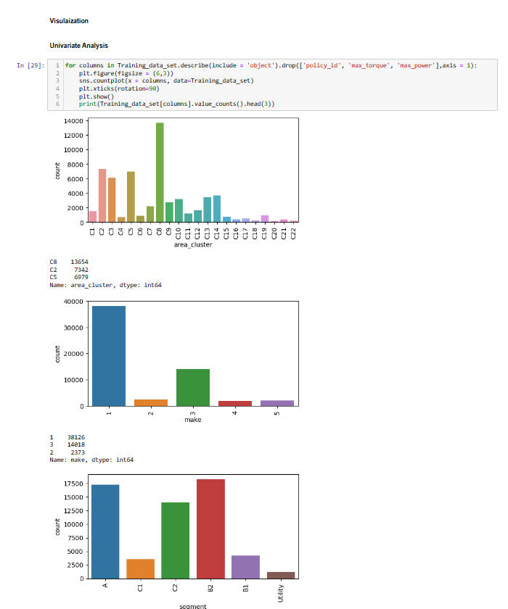
Univariate Analysis :
Target variable distribution

Slide 8
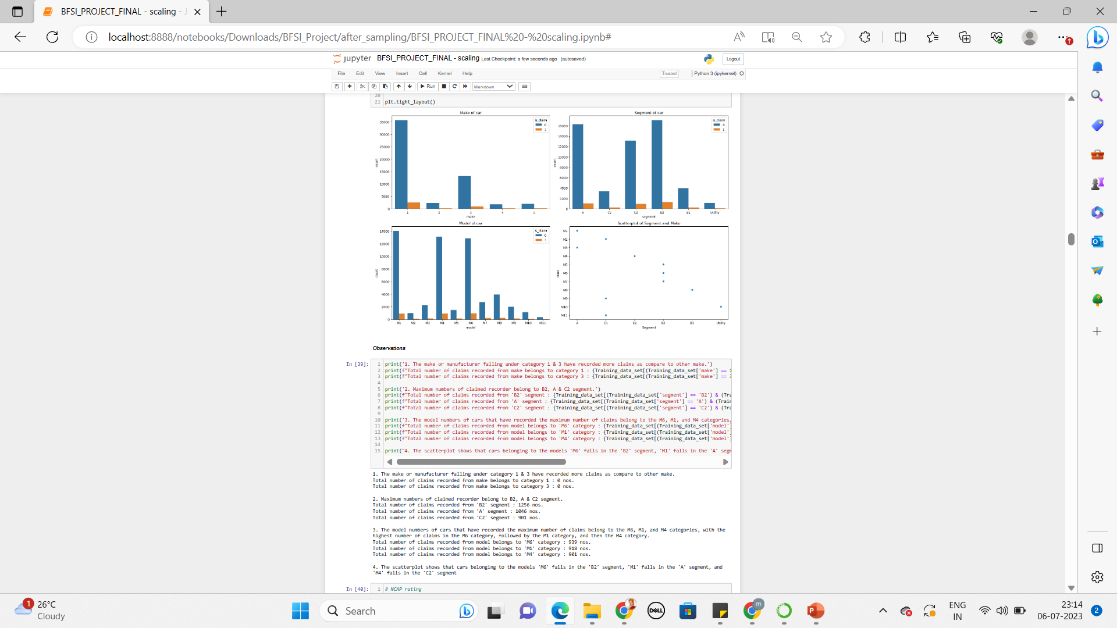
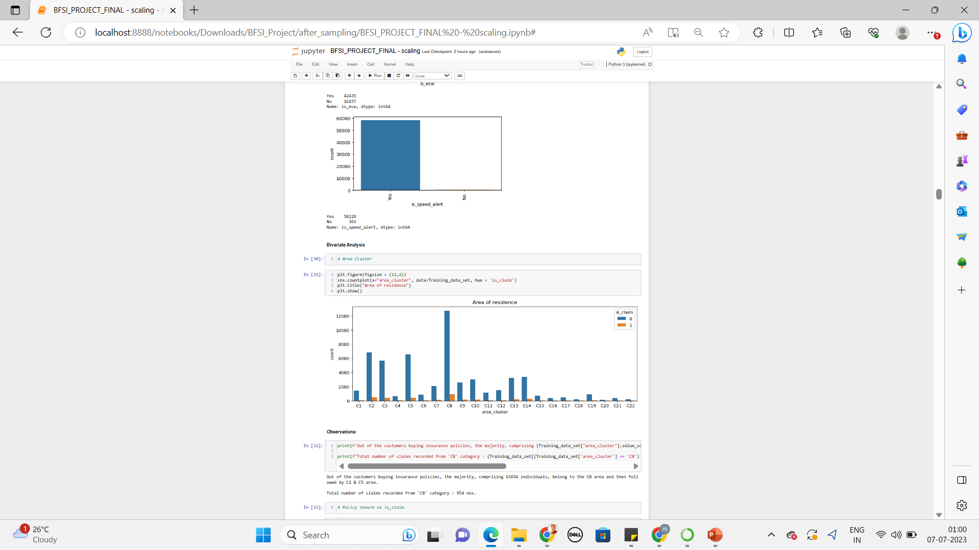
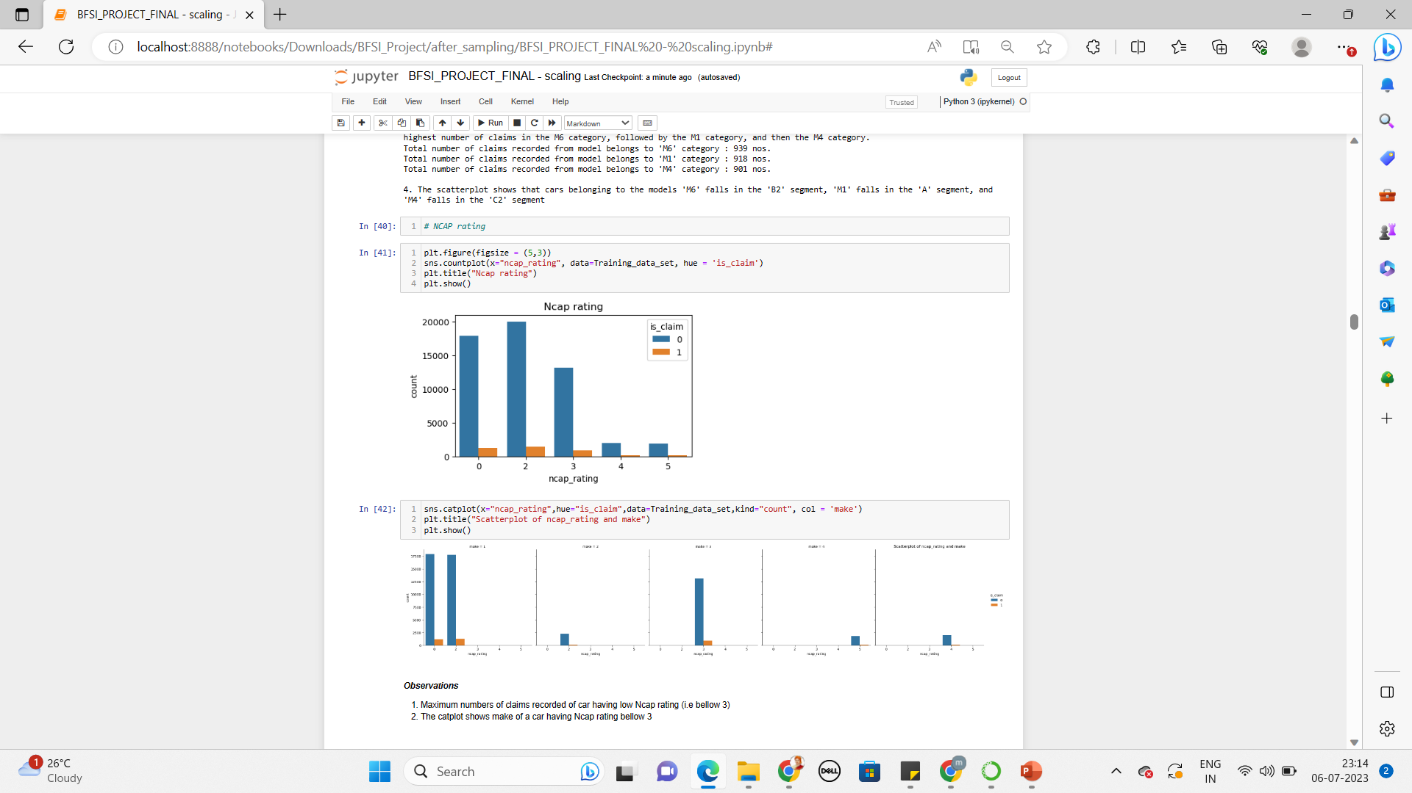
Bivariate Analysis :

Slide 9
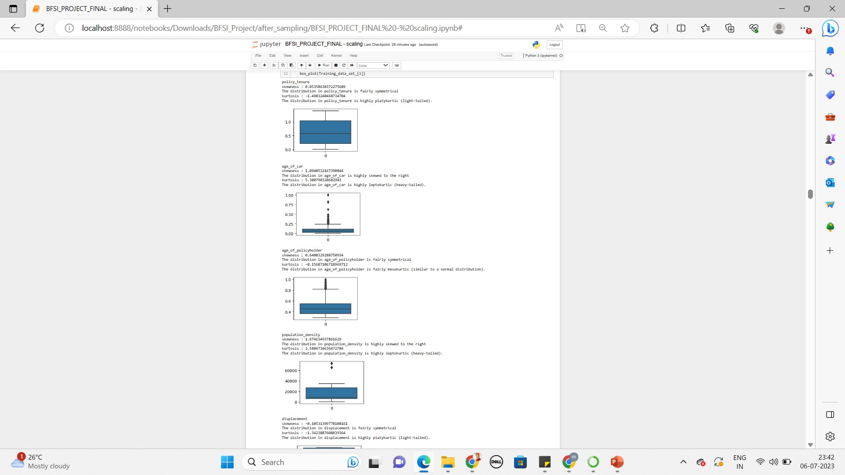
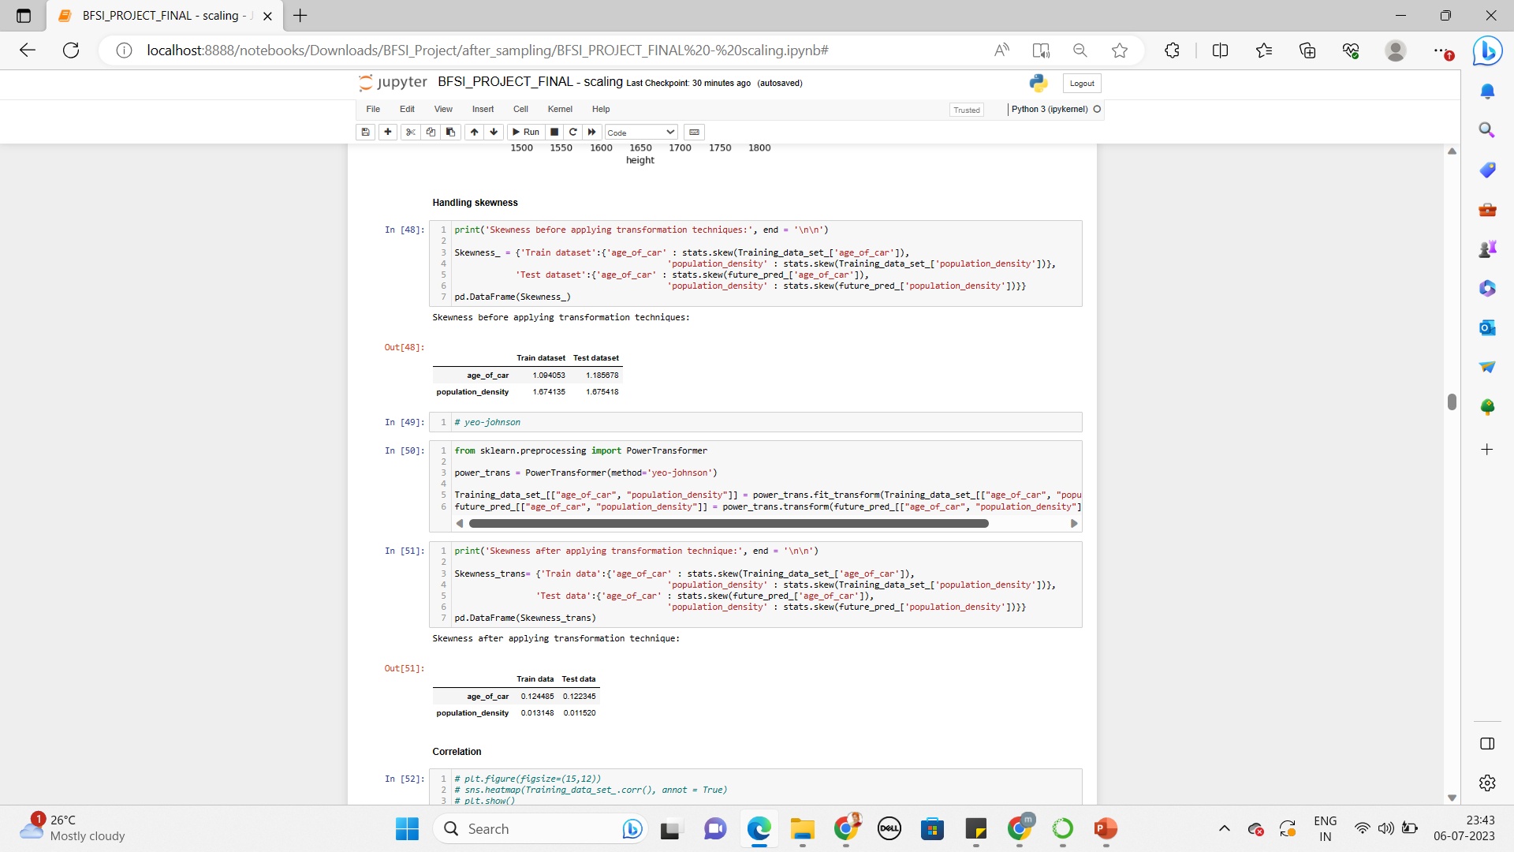
Checked for Outliers / Skewness & Kurtosis

Slide 10
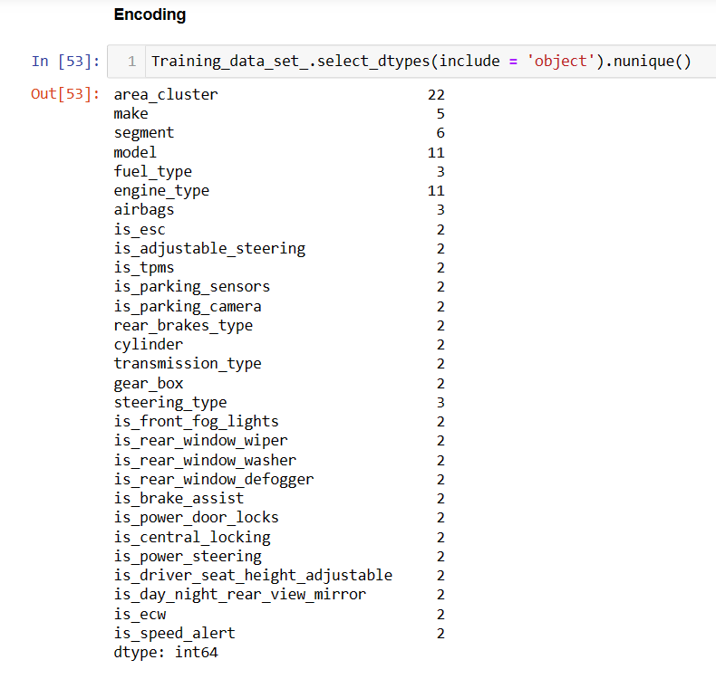
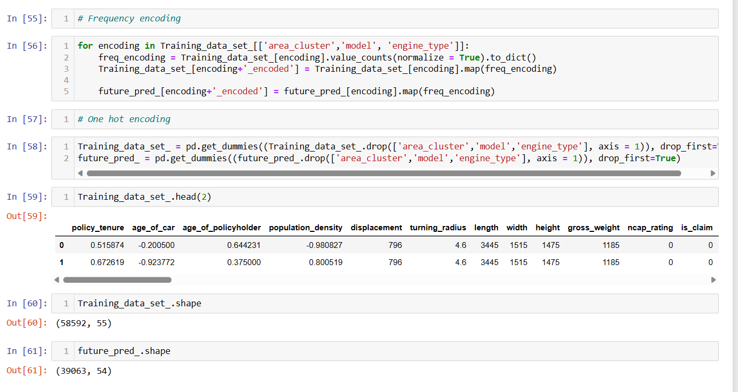
Encoding

Slide 11
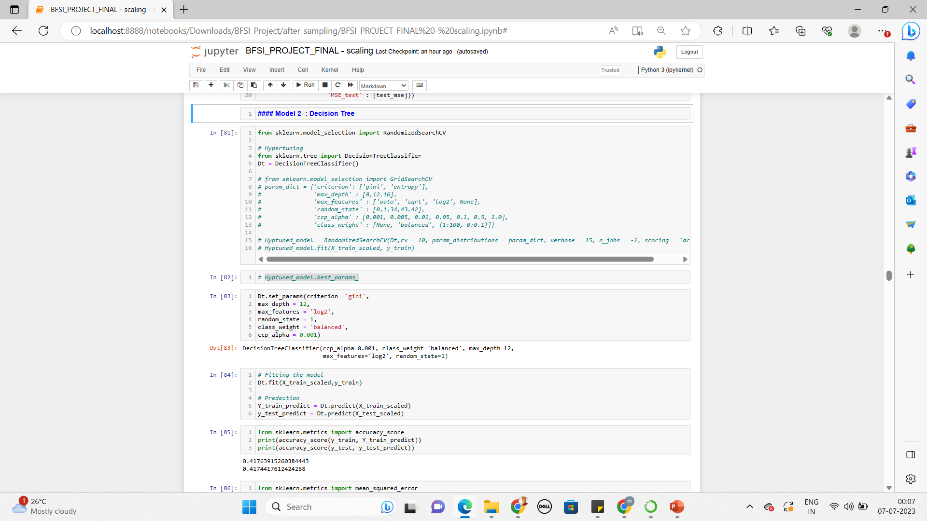
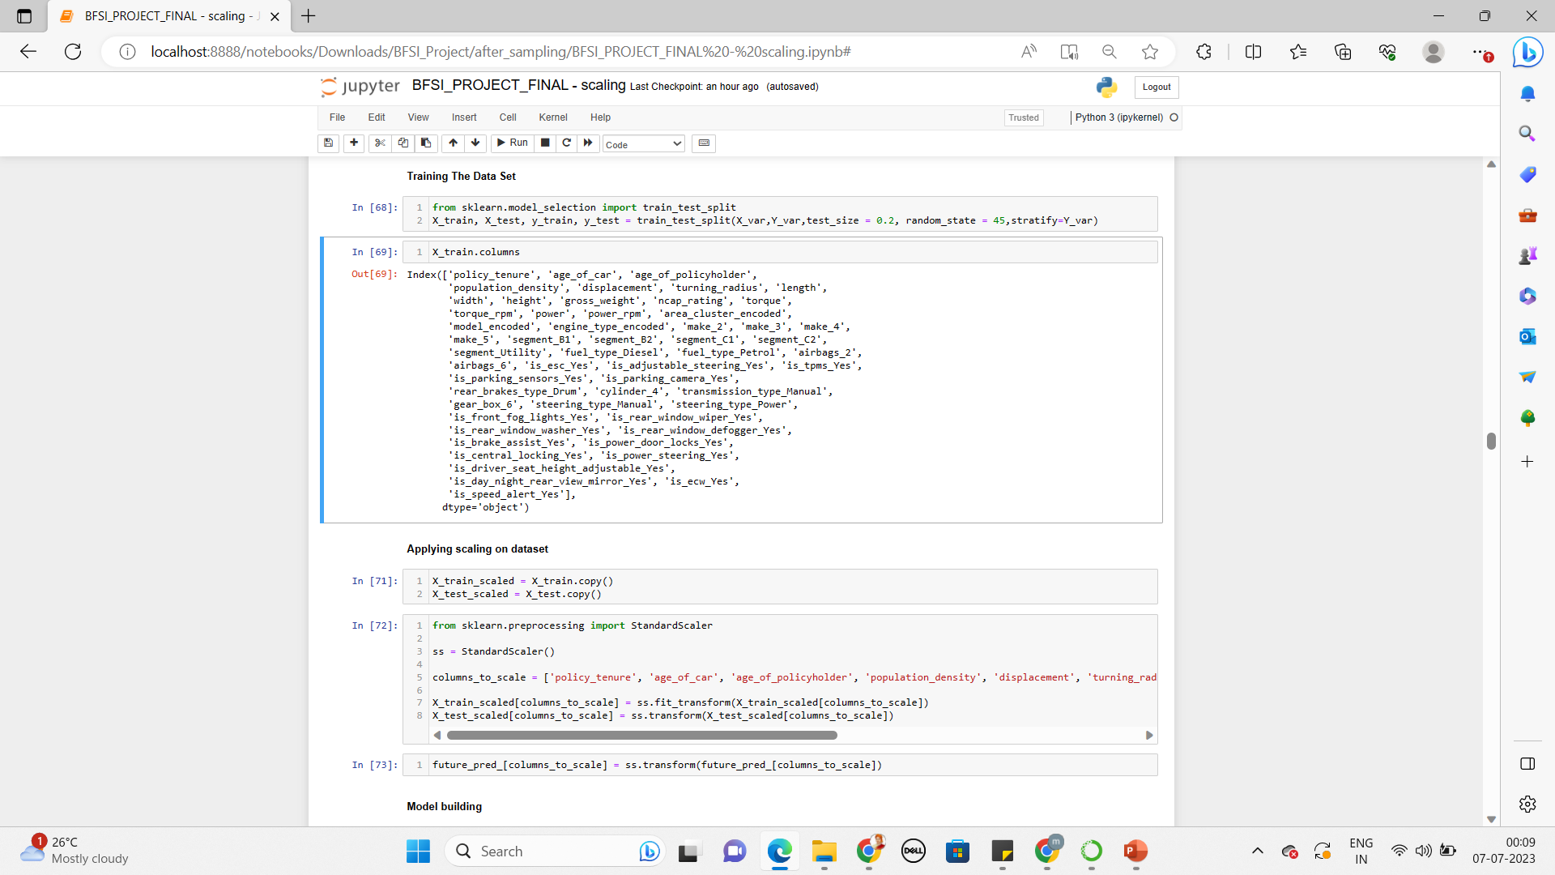
Model Development Approach
Supervised learning : Classification Model
Model selection : Considered various algorithms, such as logistic regression, decision trees & the other ensemble methods.
Training and validation
Splitting the dataset
Model Built by using all the features

Slide 12
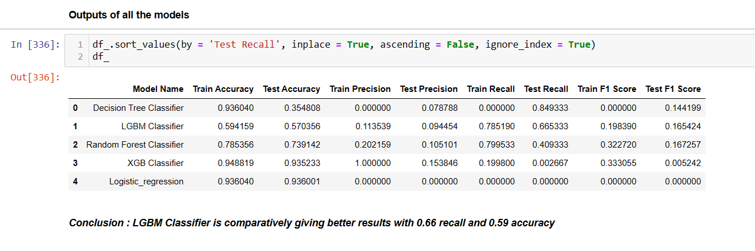
Model Evaluation and Performance

Slide 13
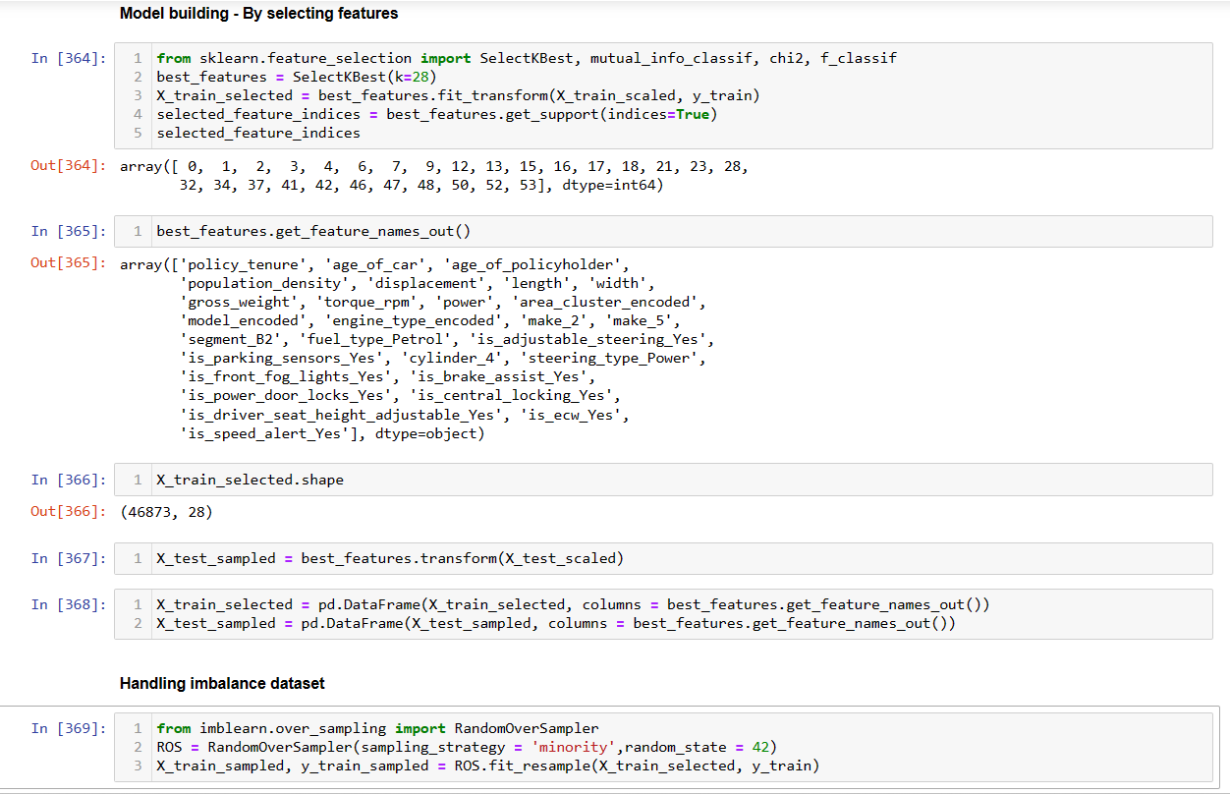
Selecting Best features and Handling imbalance dataset

Slide 14
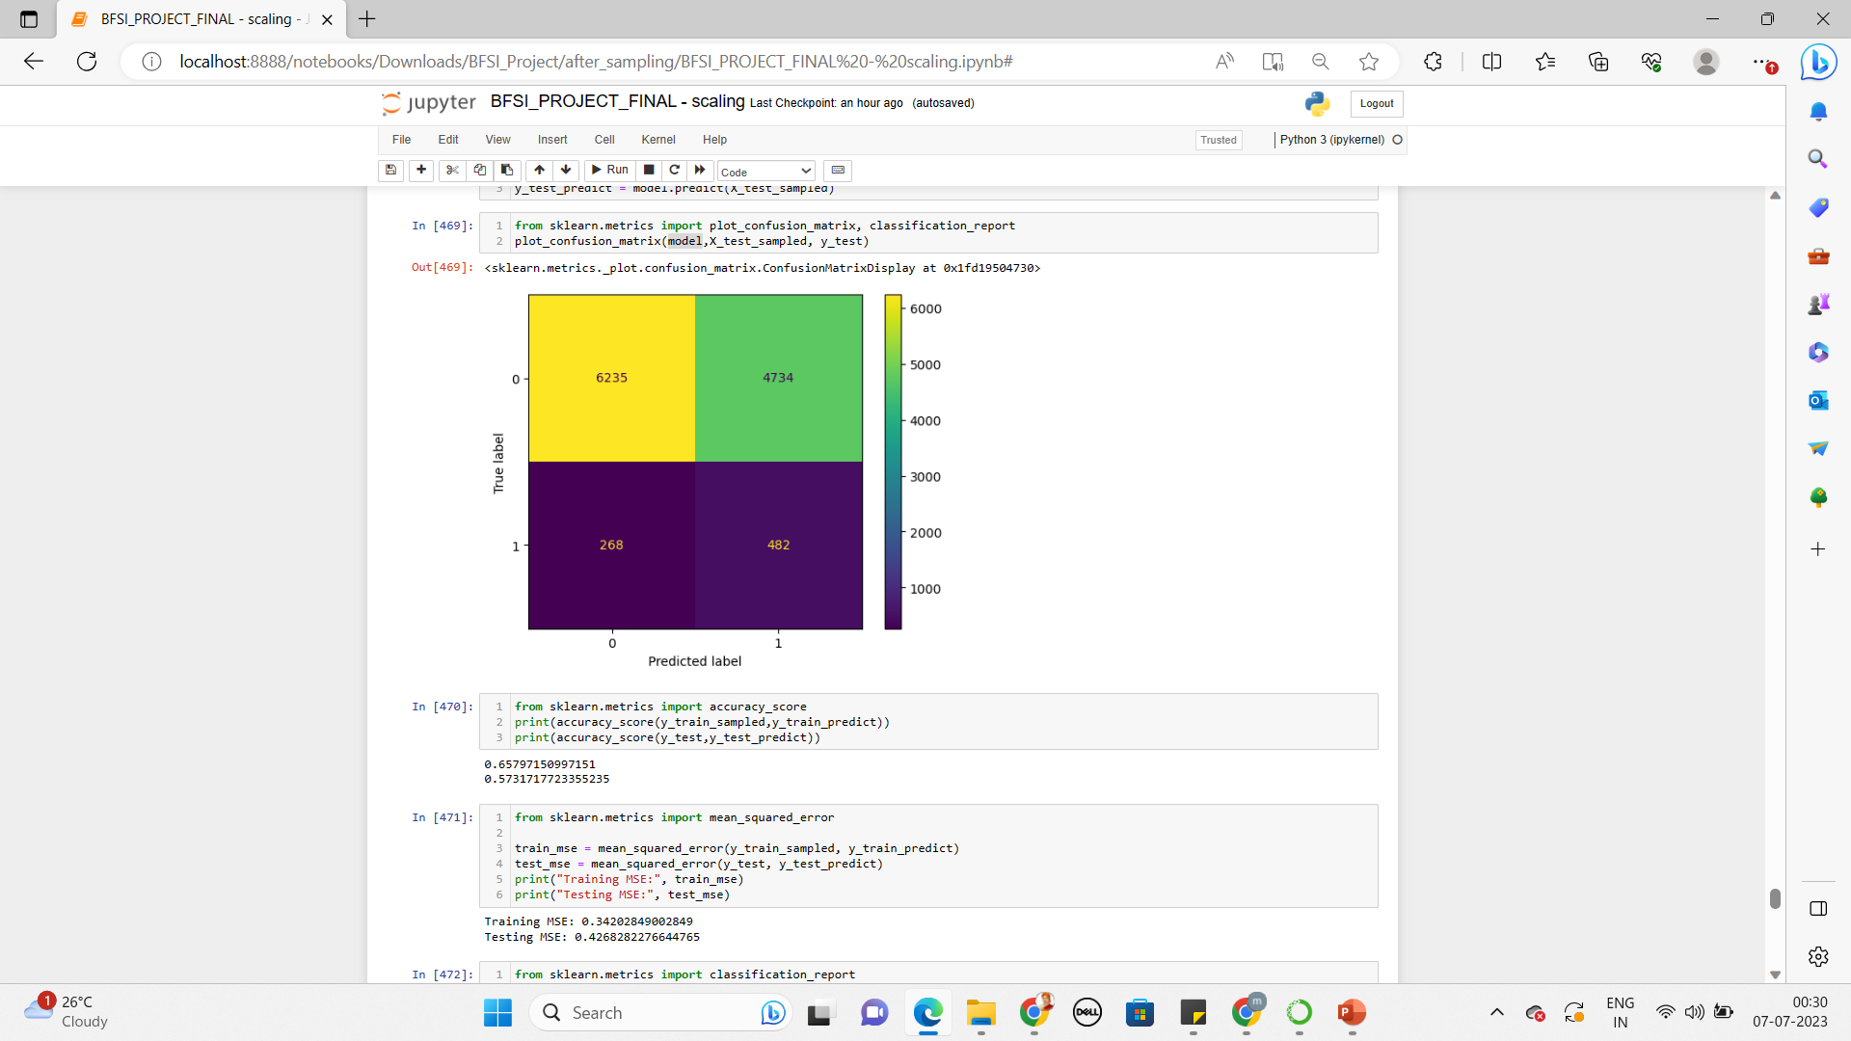
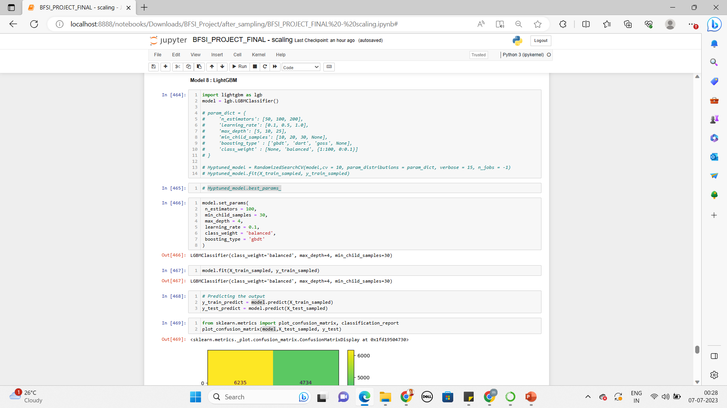
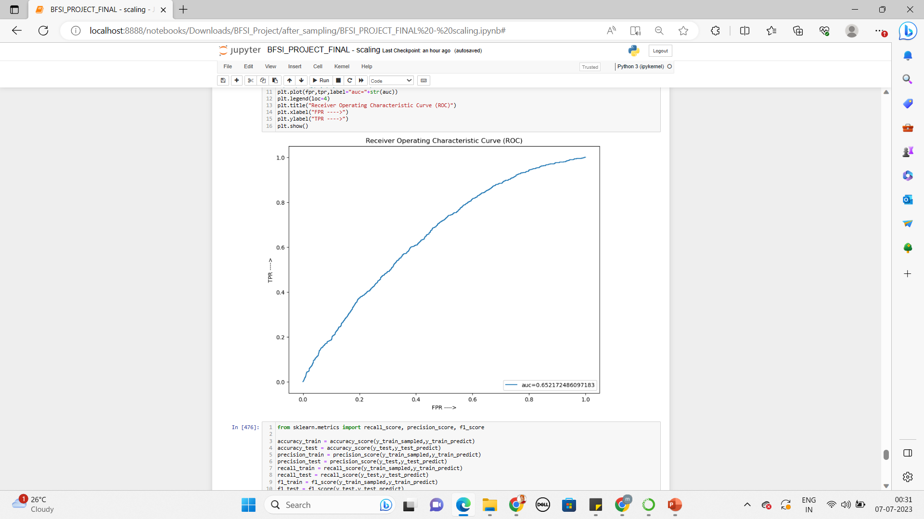
Building the model with best selected features
Confusion Matrix / Accuracy
Algorithm used : LightGBM Classifier
AUC_ROC VALUE

Slide 15
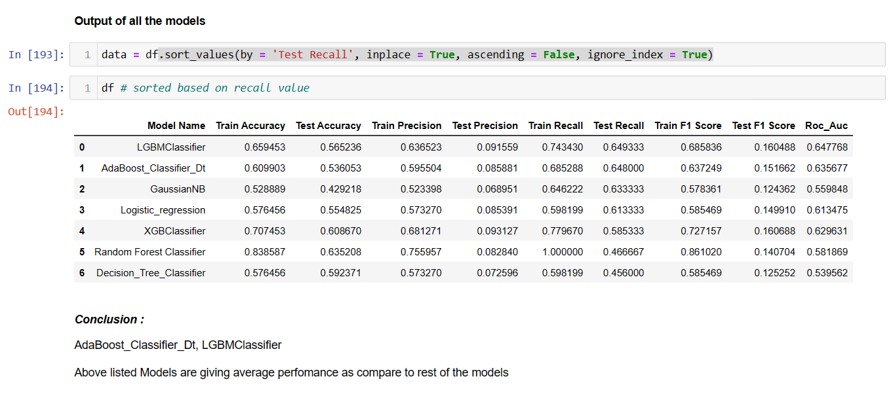
Final Result

Slide 16
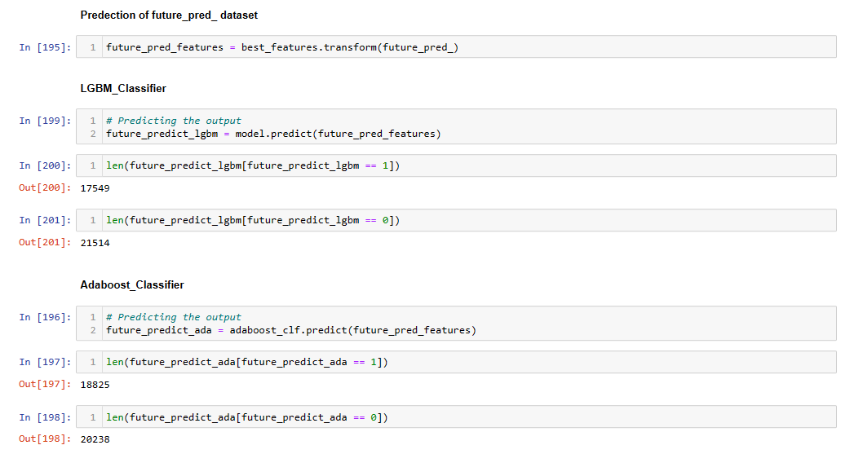
Final prediction on unseen data

Slide 17
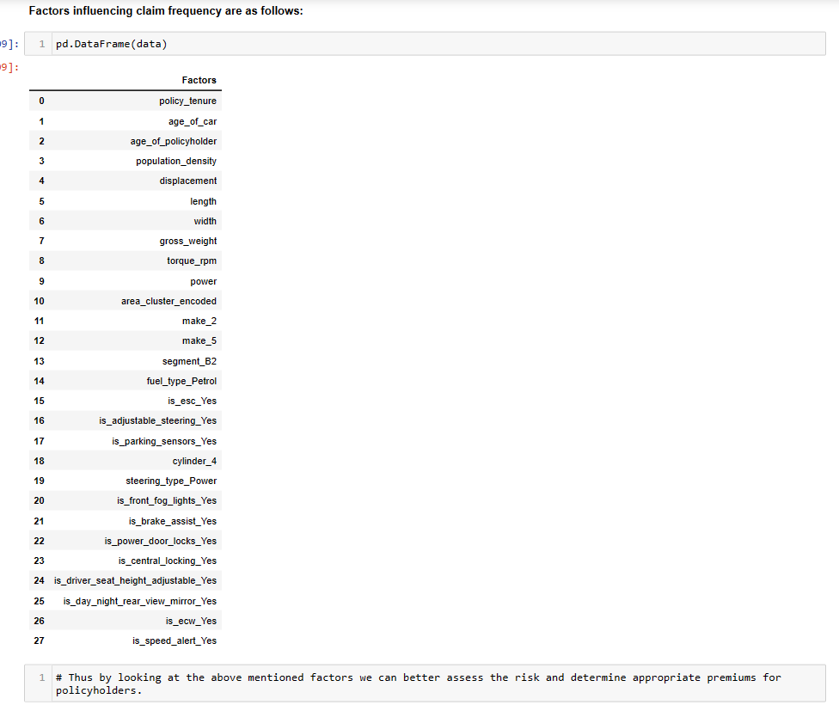
Conclusion

Slide 18
Thank you !

